Slide 1
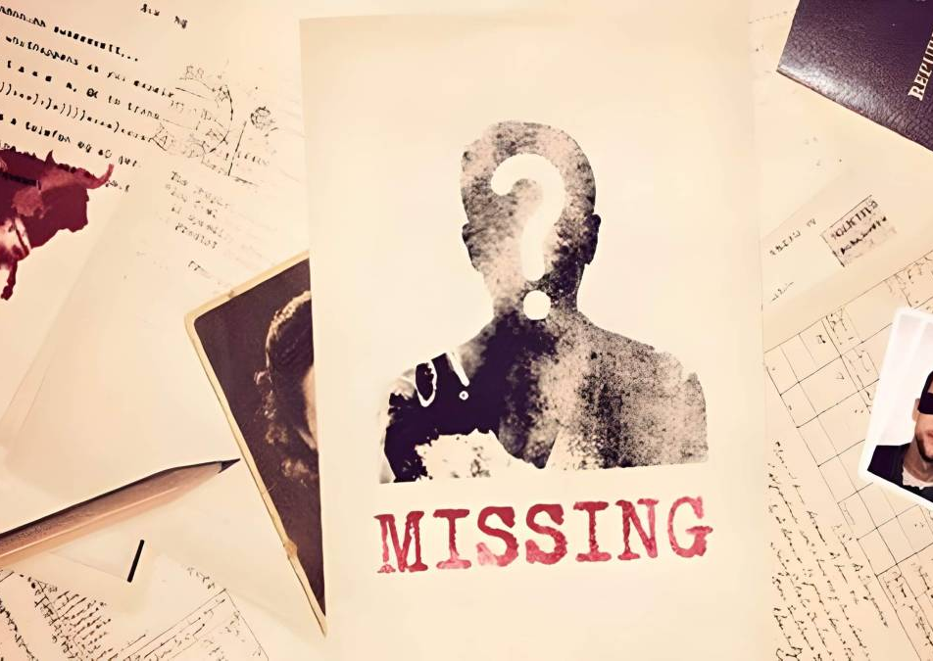
Stolen Voices, Stolen Votes
“Unmasking Enforced Disappearances in Pakistani Elections
By
Muhammad Umer
Danial Ahmed
Syeda Fatima Zahra
Muhammad Ahmed Mohsin
Muhammad Ali Farooq

Slide 2
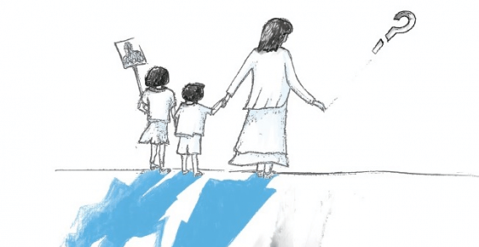
Introduction
Enforced disappearance is the act of abducting, arresting, or detaining someone against their will, and then refusing to acknowledge their fate.
“A serious human rights violation and a crime against humanity”
The 1992 Declaration lays out “three cumulative minimum elements” that should form the basis of any definition of enforced disappearance
Deprivation of liberty (whether otherwise legal or illegal) against the will of the person concerned
Involvement of officials, at least indirectly by acquiescence
Refusal to disclose the fate and whereabouts of the person concerned

Slide 3
Overview of Ethical Issues

Slide 4
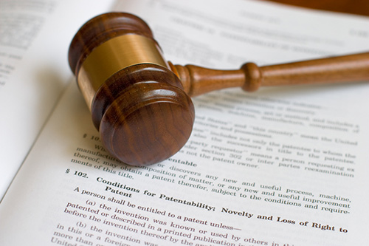
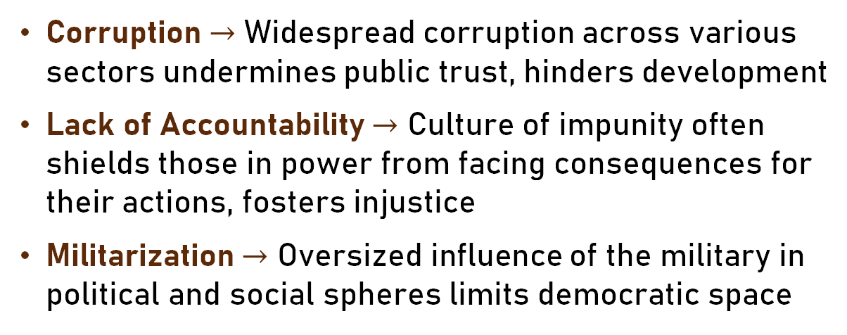
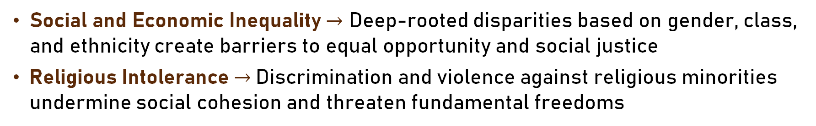
Ethical Issues: An overview
Corruption $→$ Widespread corruption across various sectors undermines public trust, hinders development
Lack of Accountability $→$ Culture of impunity often shields those in power from facing consequences for their actions, fosters injustice
Militarization $→$ Oversized influence of the military in political and social spheres limits democratic space
Social and Economic Inequality $→$ Deep-rooted disparities based on gender, class, and ethnicity create barriers to equal opportunity and social justice
Religious Intolerance$→$ Discrimination and violence against religious minorities undermine social cohesion and threaten fundamental freedoms

Slide 5
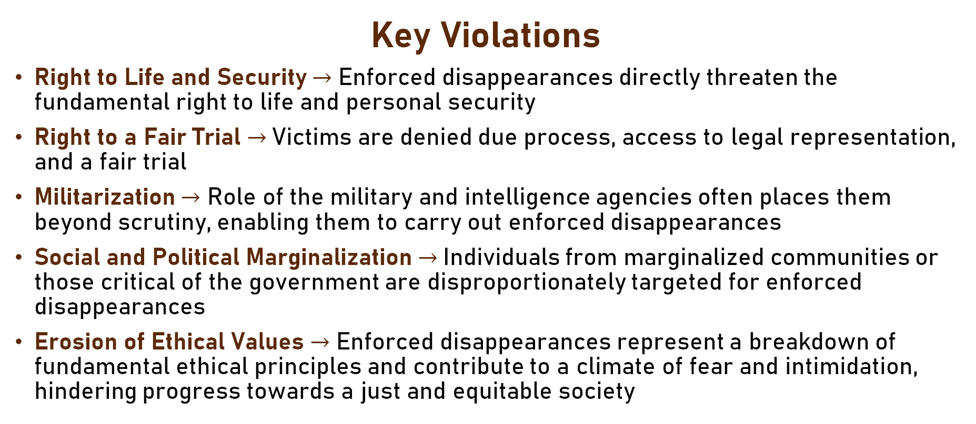
Intersection with Enforced Disappearances
Key Violations
Right to Life and Security $→$ Enforced disappearances directly threaten the fundamental right to life and personal security
Right to a Fair Trial $→$Victims are denied due process, access to legal representation, and a fair trial
Militarization $→$ Role of the military and intelligence agencies often places them beyond scrutiny, enabling them to carry out enforced disappearances
Social and Political Marginalization $→$Individuals from marginalized communities or those critical of the government are disproportionately targeted for enforced disappearances
Erosion of Ethical Values $→$ Enforced disappearances represent a breakdown of fundamental ethical principles and contribute to a climate of fear and intimidation, hindering progress towards a just and equitable society

Slide 6
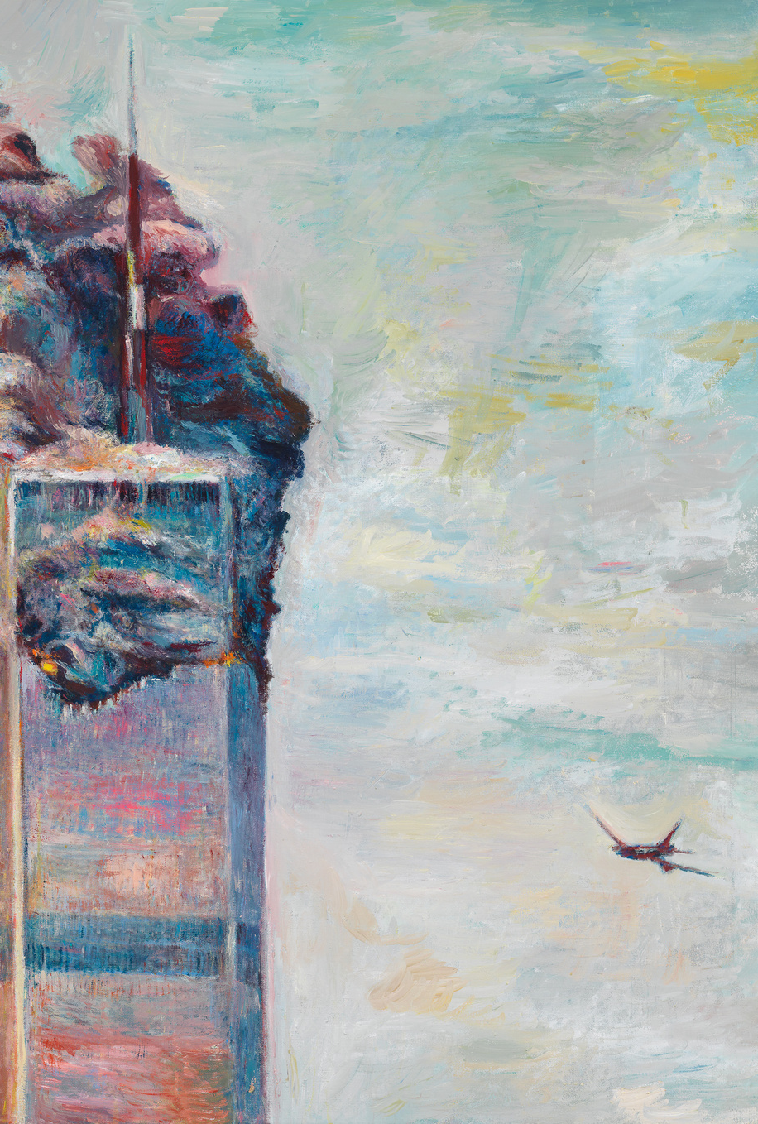
Enforced Disappearances in Pakistan: Some History
Emergence during the "War on Terror": Following 9/11 and Pakistan's alliance with the US, disappearances became a tactic to counter suspected terrorists
Expansion Beyond Counter-terrorism: Practice extended to target political dissidents, human rights activists, journalists, etc.
Baluchistan and Sindh as Epicenters: With their history of activist movements and protests, have witnessed a disproportionate number of enforced disappearances
Continuing Impunity: Despite national and international outcry, perpetrators of enforced disappearances rarely face justice

Slide 7
Analysis of Enforced Disappearances

Slide 8
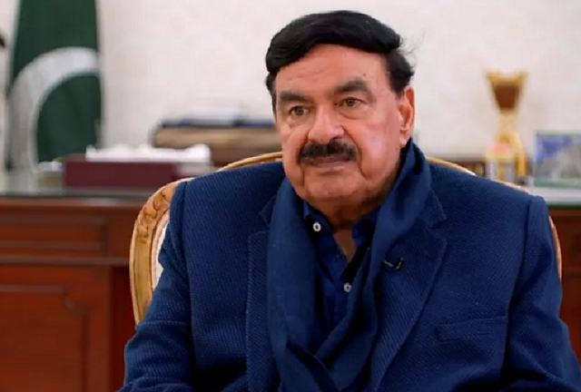
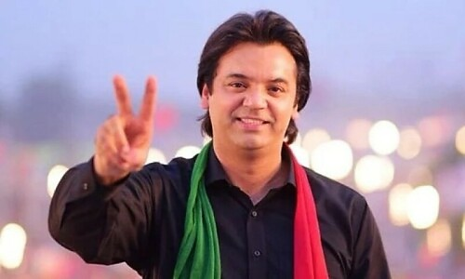
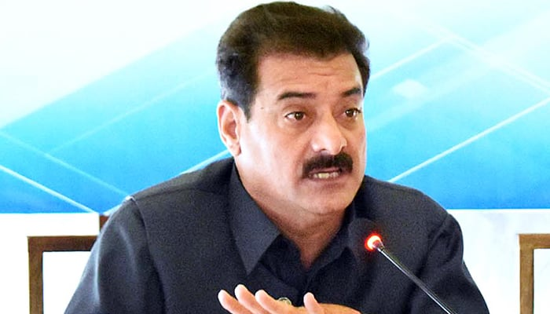
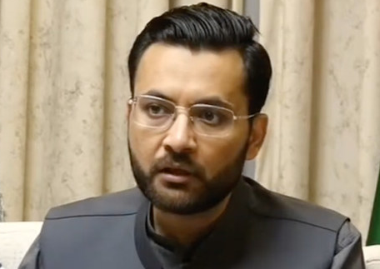
Sheikh Rasheed
Usman Dar
Few of the many people that “vanished without a trace” nearing the election period
. . .
Sadaqat Abbasi
Farrukh Habib

Slide 9
Case Studies: Victims of a Silenced Election
Sadaqat Ali Abbasi: Former member of parliament who went missing in Sep. 2023
Usman Dar: Renowned political figure and former advisor to Imran Khan, subjected to enforced disappearance in Sep. 2023
Imran Riaz Khan: A prominent journalist and critic of the government; repeatedly arrested
Baloch and Sindhi Activists: Numerous cases of disappearances targeting individuals advocating for political and human rights in these regions
... many more
“Fifty-one more cases of enforced disappearances in 2023 have brought Pakistan’s overall figure to 3,120” Defence of Human Rights (DHR)

Slide 10

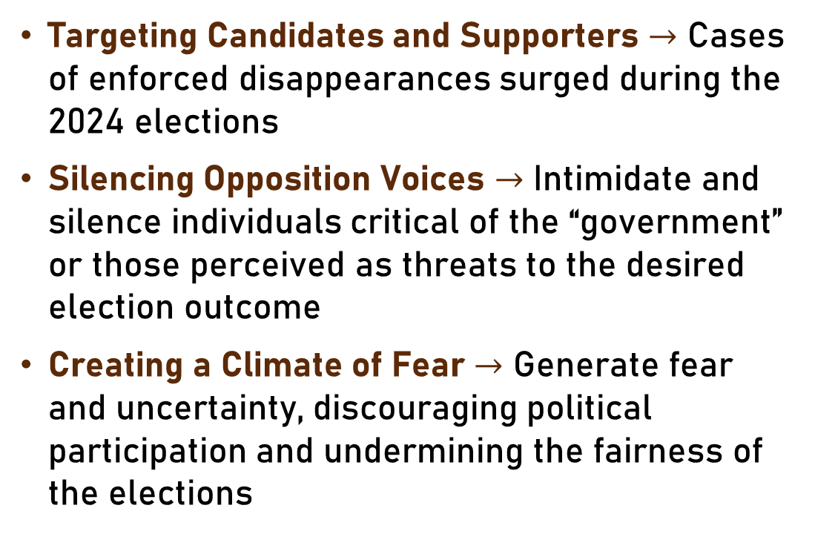
A Tool for Political Manipulation
Targeting Candidates and Supporters $→$ Cases of enforced disappearances surged during the 2024 elections
Silencing Opposition Voices $→$ Intimidate and silence individuals critical of the “government” or those perceived as threats to the desired election outcome
Creating a Climate of Fear $→$ Generate fear and uncertainty, discouraging political participation and undermining the fairness of the elections

Slide 11
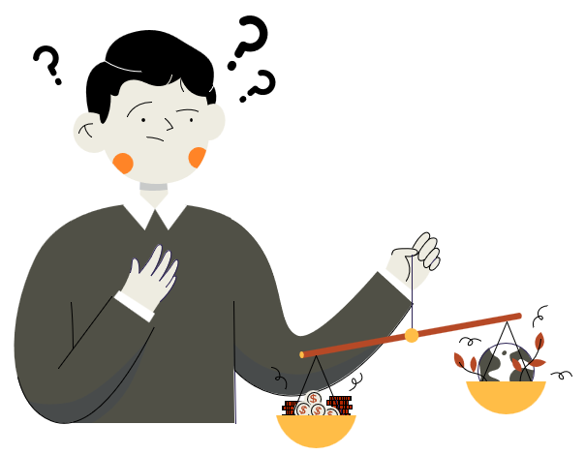
Ethical Fallout: A Society Scarred
Erosion of Democratic Principles
Violation of fundamental human rights
Undermining free and fair elections
Weakening the rule of law and accountability
Impact on Victims and Families
Psychological trauma and emotional distress
Loss of loved ones and the agony of uncertainty
Economic hardship and social stigma
Loss of Public Trust
Growing distrust in government and institutions
Fear of expressing dissent or political opinions
Erosion of social cohesion and stability

Slide 12

Stakeholders A Complex Web of Interests
Victims and Families: Seeking justice, truth, and accountability for their missing loved ones
Government and Security Agencies: Maintaining control, suppressing dissent, and achieving political goals through enforced disappearances
Political Parties and Candidates: Navigating a climate of fear, seeking to protect their members, and striving for fair elections
Civil Society Organizations and Human Rights Defenders: Advocating for victims, demanding accountability, and working to raise awareness about enforced disappearances
International Community: Monitoring the human rights situation in Pakistan, urging the government to address enforced disappearances, and offering support for human rights initiatives

Slide 13

Current Responses: A System Failing Victims
Commission of Inquiry on Enforced Disappearances (COIED): While established, COIED suffers from following limitations:
Lack of independence and resources
Limited investigative powers
Inability to hold perpetrators accountable
Judicial System: Response to enforced disappearances has been inadequate:
Lack of independence and political influence
Slow and inefficient investigations and prosecutions
Fear of reprisals in judges and lawyers
International Pressure: Impact remains limited due to:
Lack of effective enforcement mechanisms
Geopolitical considerations and competing interests

Slide 14
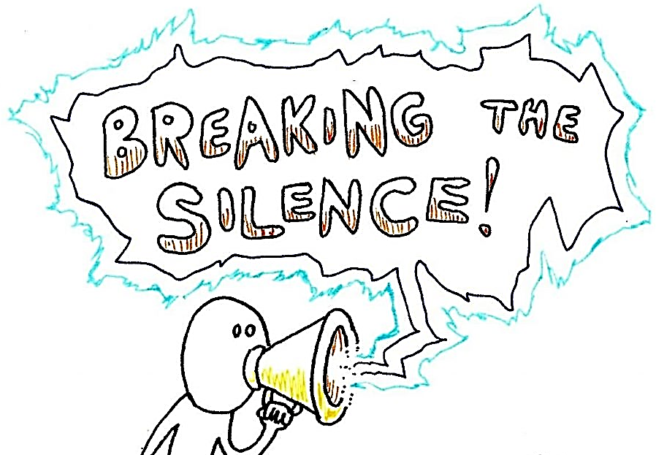
Responsibility of Individuals

Slide 15

Breaking the Silence
Be Informed
Raise Awareness
Demand Accountability
Support Victims and Families
Promote a Culture of Human Rights
The Role of Individuals

Slide 16
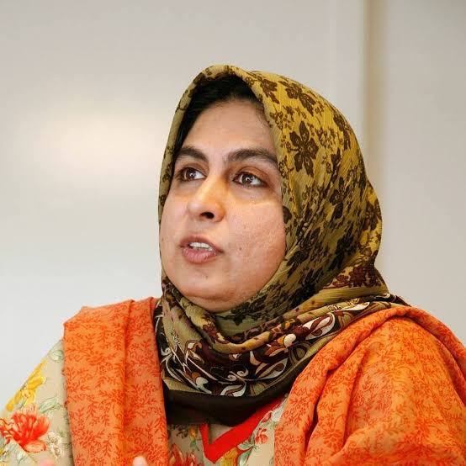
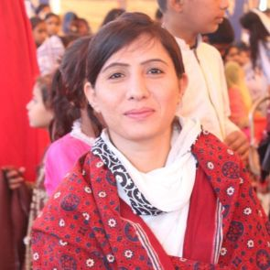
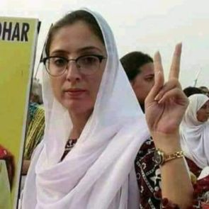
Leading the Charge: Faces of Courage and Resistance
Amina Masood Janjua
Sorath Lohar
Sasui Lohar
Chairperson Defence of Human Rights Pakistan
Tirelessly campaigning against enforced disappearances, despite facing threats and intimidation
Co-founders of Voice of Missing Persons of Sindh, sisters who have bravely led protests and hunger strikes for years, demanding justice for their missing brother and countless others, even in the face of harassment and violence

Slide 17
Breaking the Silence: Fear and Apathy
Fear of Reprisals: Fear of retaliation or social stigma can discourage individuals from speaking out
Lack of Knowledge: Many people may not be fully aware of the issue or how to effectively contribute to solutions
Feeling of Powerlessness: Individuals may feel that their actions alone cannot make a difference
"Inaction breeds doubt and fear. Action breeds confidence and courage. If you want to conquer fear, do not sit home and think about it. Go out and get busy." Dale Carnegie
The Lawyers' Movement of 2007 demonstrated the ability of ordinary citizens to overcome fear and apathy, uniting to demand justice and the restoration of an independent judiciary

Slide 18

Collective Action The Power of Unity
Supporting Human Rights Organizations Contribute to organizations working on enforced disappearances through donations, volunteering
Joining Protests and Demonstrations Participate in peaceful protests and rallies to raise public awareness
Utilizing Social Media Share information, stories, and calls to action on social media platforms

Slide 19
Conclusion

Slide 20
Conclusion
The crisis of enforced disappearances casts a long shadow over Pakistan's pursuit of a truly democratic and just society
We cannot stand idly by while individuals vanish without a trace, their voices silenced, and their rights violated
It is our collective responsibility, as citizens, as human beings, to demand an end to this inhumane practice
“Let us raise our voices in unison, demanding accountability, transparency, and justice for all”

Slide 21
Thank you!

